Slide 1
Innovative test solution
Provider
- Probe pin Datasheet -

Slide 2
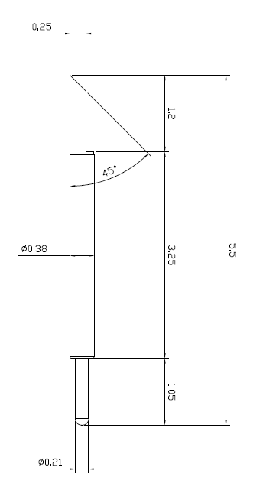
※ POGO type – Kelvin solution (0.5 pitch)
IVB-SPR-550-038-A157-00
Pitch | 0.50mm
Total Length | 5.5mm
Use Length | 5.05mm
Use Stroke | 0.50mm
Recommended Top Plunger Stroke | 0.30mm
Recommended Bottom Plunger Stroke (Pre-load) | 0.15mm
Max Stroke | 0.9mm
Spring Force at Use Stroke | 31gf at 0.45mm Stroke
Operating Temperature | -40 to 140°C
DC Resistance | Avg. 50.0mΩ at 0.45mm stroke
Current Rating | 1.7A
Self Inductance | 1.56nH
Bandwidth @ -1dB | 8.4GHz
Top Plunger | Hardened BeCu / Au Plated
Bottom Plunger | Hardened BeCu / Au Alloy Plated
Barrel | Alloy / Au Plated
Spring | Music Wire / Au Plated
Insertion Life | 100,000 cycles at 0.45mm Stroke

Slide 3
Thank you.

